Slide 1

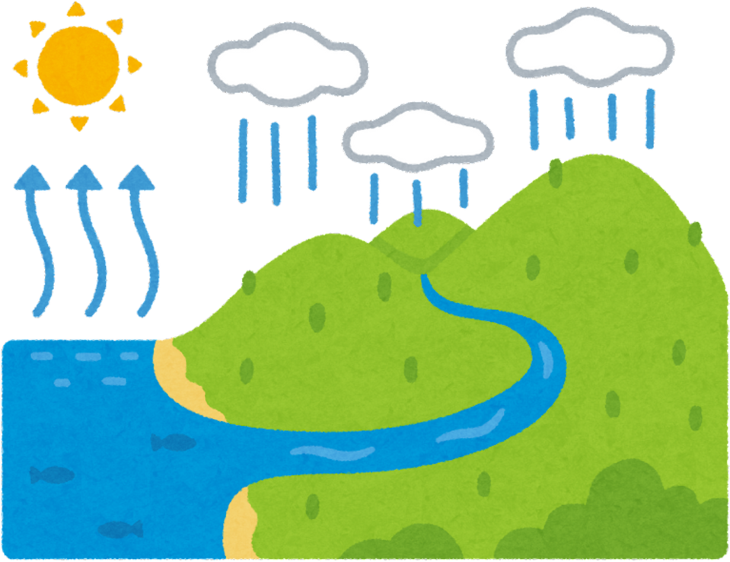
The what?
Frequency = how often hazards occur
Extent = how widespread the hazard is
Severity = how damaging the hazard is

Slide 2
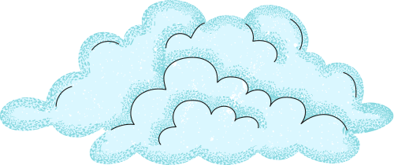
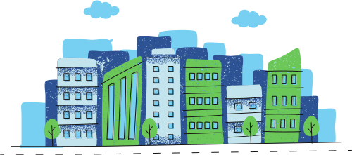
Syllabus
Are the following examples of frequency, extent or severity?
Tropical cyclones are forming more often during the cyclone season.
Flooding from a cyclone affects multiple states and large river catchments
A cyclone causes stronger winds, heavier rainfall and greater damage to homes.
Storm surge flooding reaches further inland than in previous events.
Cyclones are reaching higher categories more quickly before landfall.
A region experiences tropical cyclones almost every year.
Notes:
Tropical cyclones are forming more often during the cyclone season = Frequency
Flooding from a cyclone affects multiple states and large river catchments = Extent
A cyclone causes stronger winds, heavier rainfall and greater damage to home = Severity
Storm surge flooding reaches further inland than in previous events = Extent
Cyclones are reaching higher categories more quickly before landfall = Severity
A region experiences tropical cyclones almost every year = Frequency

Slide 3
Factors impacting cyclones
Natural factors such as climate patterns, ocean temperatures, topography and location affect how often hazards occur and where they happen.
Human-induced factors such as climate change, urbanisation and land-use change can increase the extent and severity of hazards by making them more intense and exposing more people and infrastructure to harm.

